Slide 1
To compare different amounts of money
Independent task
Maths
Mrs Bramble & Miss Sidhu

Slide 2
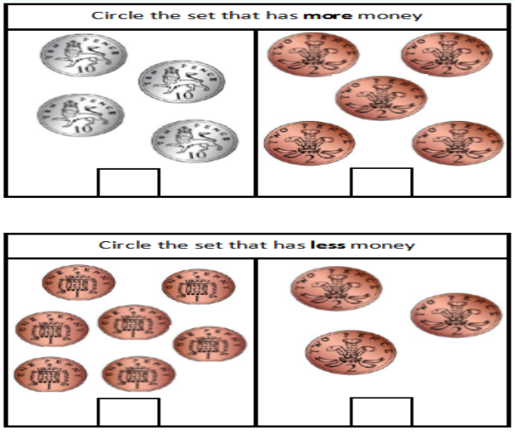
Independent Task 1

Slide 3
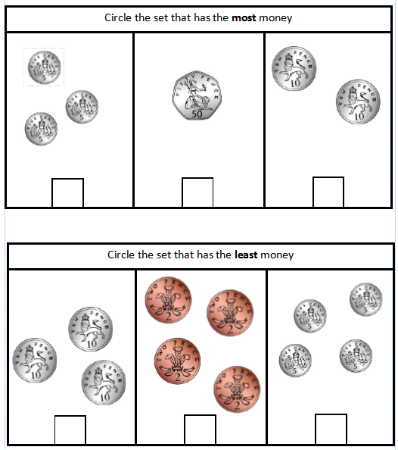
Independent Task 2

Slide 4
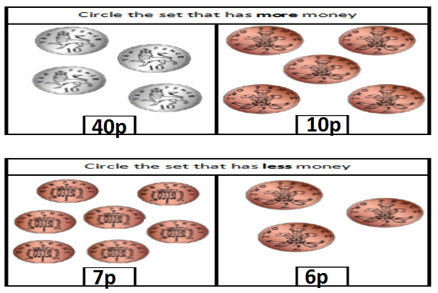
Answers

Slide 5
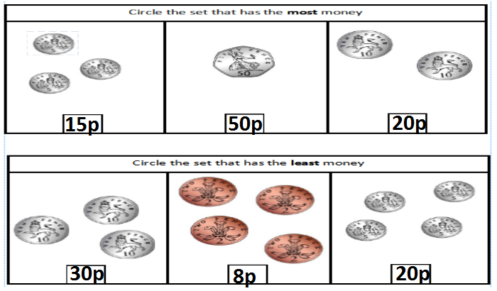
Answers

