Slide 1
Solving addition and subtraction word problems
Mathematics
Miss Brinkworth

Slide 2
Part A - Follow our SC to answer these
At the school fete the raffle raised £168. The cake stall raised £176. How much did both stalls raise altogether?
368 pupils visited Edinburgh Zoo on Saturday. 277 more visited the Zoo on Sunday than Saturday. How many children went to the Zoo on Sunday?
Olive Grove Primary School has 276 pupils. The secondary school next door has 648 more pupils than the primary school. How many pupils were there at the secondary school?

Slide 3
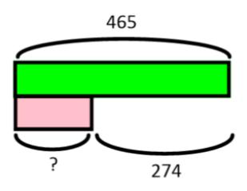
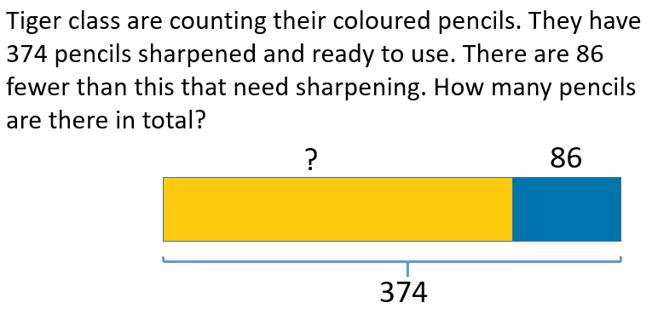
Part B
Make up your own word problem using this bar model
Can you spot my mistake here?

