Slide 1
Forming shapes from diagonals
Downloadable resource
Lesson 6 of 8
Mathematics
Dr Rim Saada

Slide 2
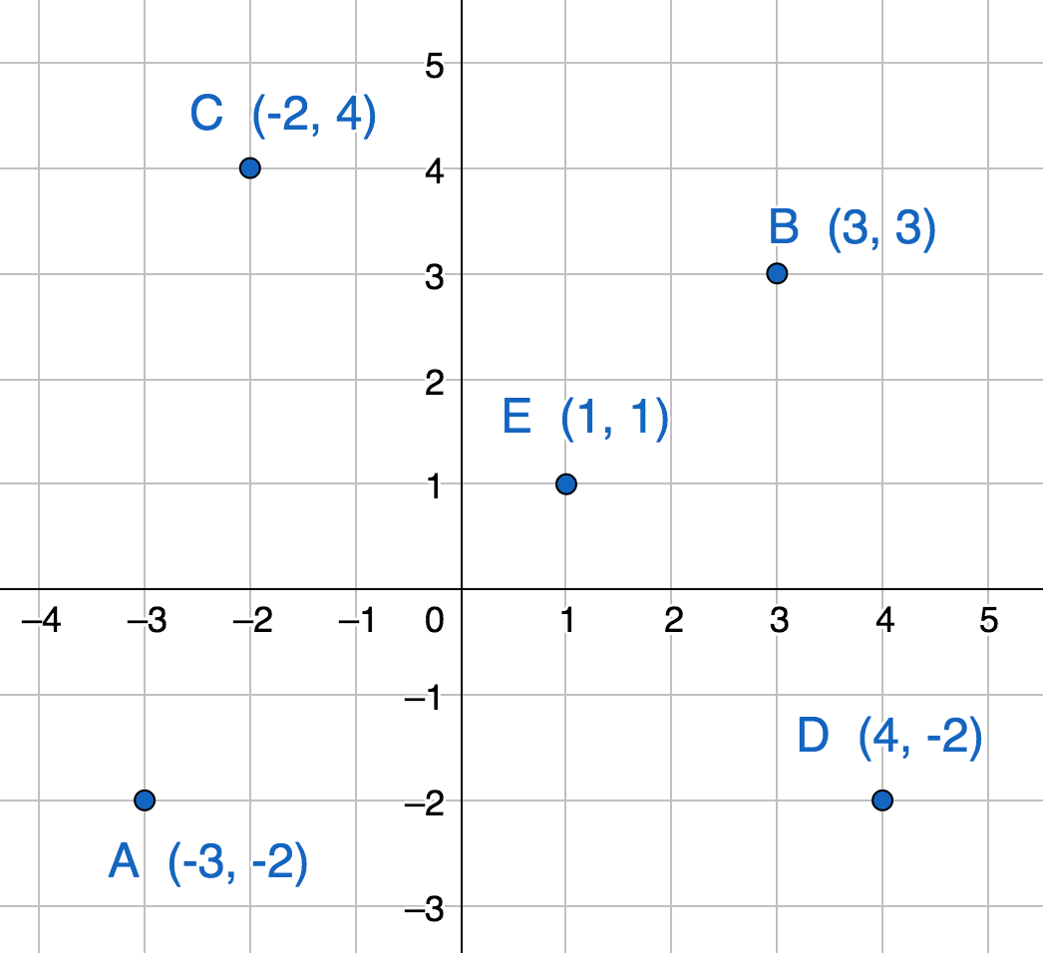
Complete the code to move the robot.
A to B: < ( )>< ( )>
B to C: < ( )>< ( )>
C to D: < ( )>< ( )>
D to E: < ( )>< ( )>
E to A: < ( )>< ( )>
N
Describe a different ‘loop’ that visits each point.

Slide 3
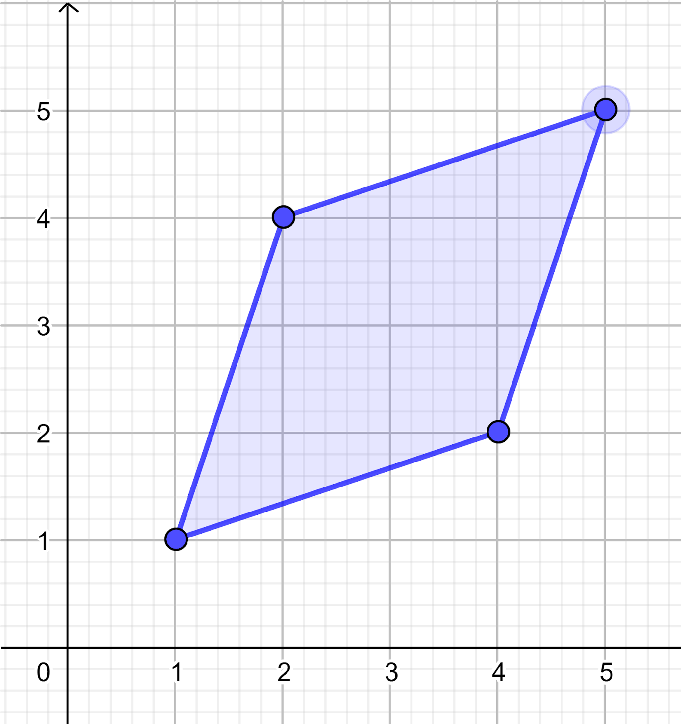
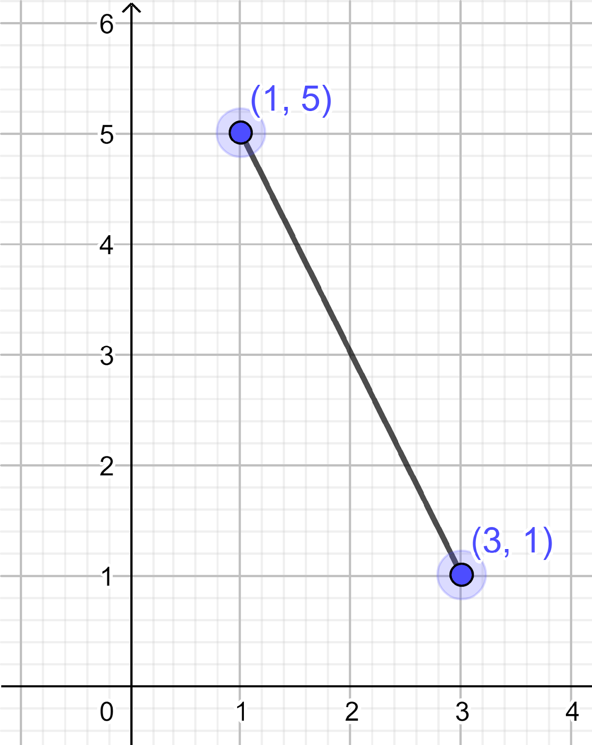
1) Explain why this shape is a rhombus.
2) ) This line segment is one diagonal of a rhombus. Give the coordinates of 2 points which could be the other vertices of this rhombus.

Slide 4
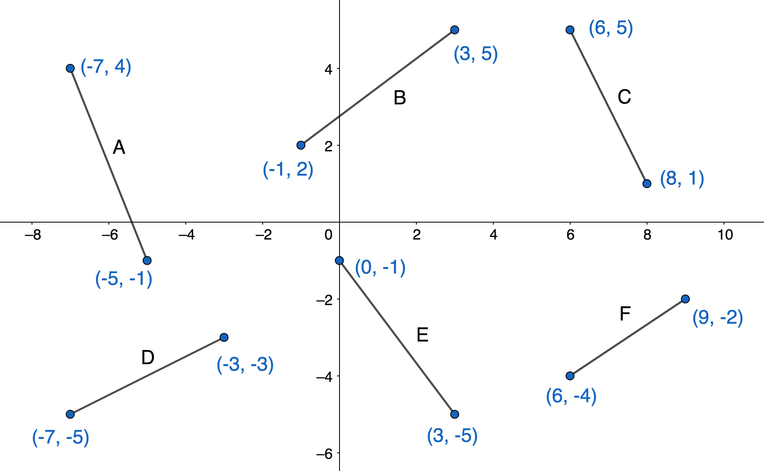
Which of the line segments below are equal in length?

