Slide 1
Ecological relationships and classification
Lesson 2 - Representing Food Chains
Biology - Key Stage 3
Miss Lewis

Slide 2
4
7
1
Lettuce
Slug
Hedgehog
Credit: SVG

Slide 3
12
4
1
Dandelions
Rabbits
Fox
Credit: SVG

Slide 4
12
8
5
1
Seaweed
Limpet
Starfish
Seagull
Credit: SVG

Slide 5
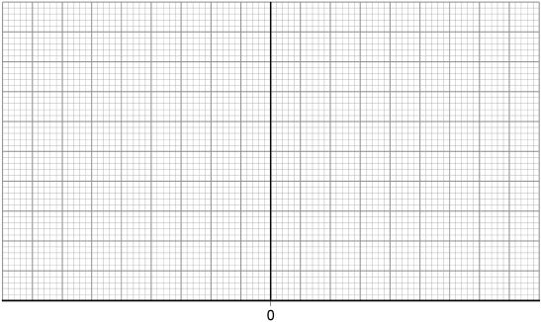
Credit: SVG

Slide 6
Draw the pyramid of biomass for the food chain below.
Tiny green plants
1000 kg
Shrimp
100 kg
Cod
10 kg
Seal
1 kg
Credit: SVG

Slide 7
Quick Fire Questions
What is the length of each bar equal to?
What goes on the bottom of the pyramid?
What goes next?
Then?
What units are biomass measured in? Kilograms, metres or Newtons?
How are the bars aligned?
What must you add to the pyramid at the end?
Notes:
Is the length of each bar equal to the number of each organism?
Is there a key?
Is the height of each bar the same?
Do the bars all align in the centre?
Is the producer along the bottom?
Does the food chain work up the pyramid?
Have you added labels to the bars?

Slide 8
Well done!
Now complete the exit quiz.

