Slide 1
Lesson 6: The CSS Box Model
KS4 HTML and CSS
Computing
Ben Garside
Materials from the Teach Computing Curriculum created by the National Centre for Computing Education

Slide 2
Task 1 - The CSS Box Model
Use the following link to access a repl.it where you can apply the CSS box model as you saw in the demonstration:
oaknat.uk/comp-L6-activity
Steps can be found on the following slides
Margin
Border
Padding
Content

Slide 3
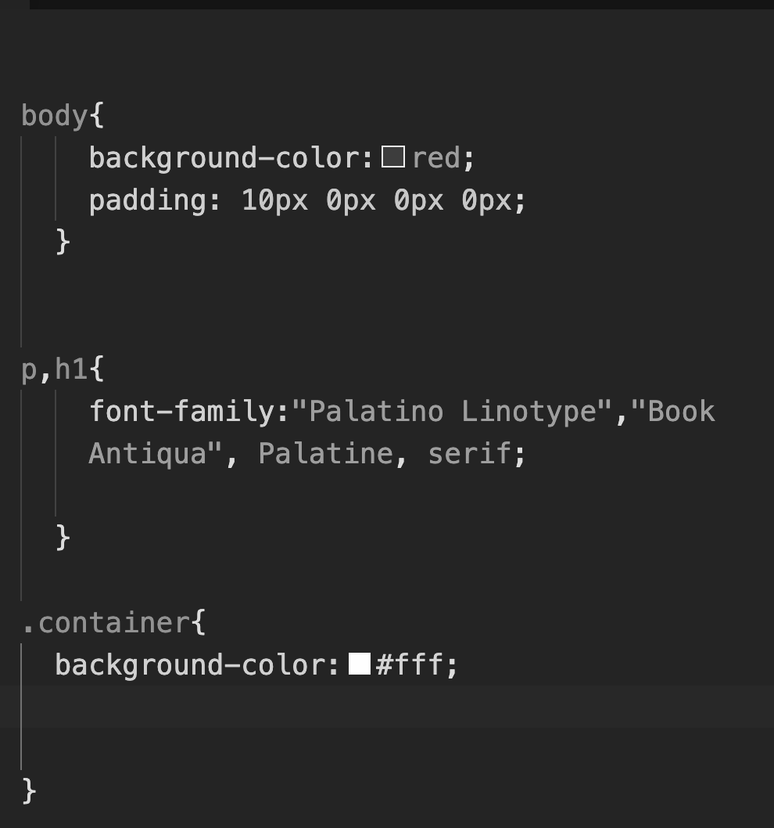
Task 1 - steps part 1
Navigate to the style.css file
Change the background-color inside body to a colour of your choice
Now add a different background-color to .container
Run the program to view the effect

Slide 4
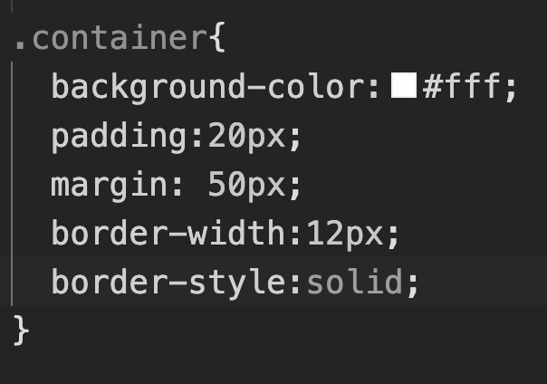
Task 1 - steps part 2
Add the following CSS to .container:
padding:20px;
margin: 50px;
border-width:12px;
Border-style:solid;
Run the program again to view the effect

Slide 5
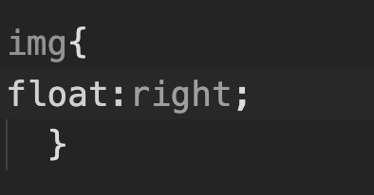
Task 1 - steps part 3
Add the following CSS to img:
float:right
Run the program again to view the effect

Slide 6
Task 1 - steps part 4
Now experiment with the values inside .container or any other tags to see what the effect is when you change the values.
Example: Try increasing the margin to 200px
Read more about the box model to see what other effects you can achieve:
https://www.w3schools.com/css/css_boxmodel.asp
Margin
Border
Padding
Content

Slide 7
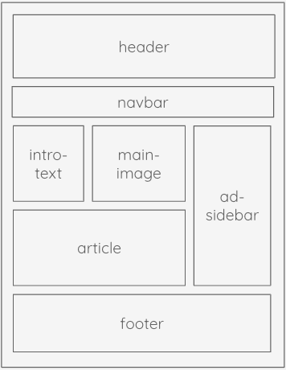
Activity 2 – Laser Tag
Now that you have experience applying the CSS Box model, your next task requires you to:
Pick an existing page on your laser tag website
Spend time designing a layout
Apply the CSS Box Model to help you achieve the layout

