Slide 1
Draw and recognise graphs of the form y = kx
Maths
Miss Davies

Slide 2
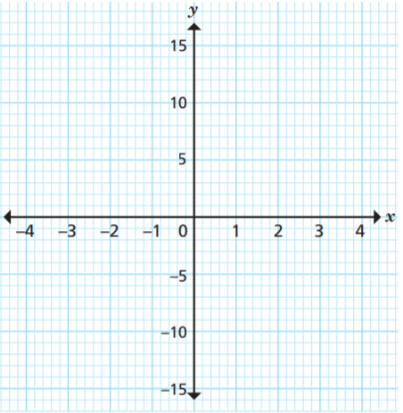
Draw and recognise graphs of the form y = kx
1. a) Complete the table of values for
y = 4x
b) Write the values in the table as coordinates.
(−2, −8), ( , ), ( , ), ( , ),( , ), ( , )
c) Plot the graph of y = 4x
y | -2 | -1 | 0 |  | 2
x | -8 |  |  | 4 |  | 12

Slide 3
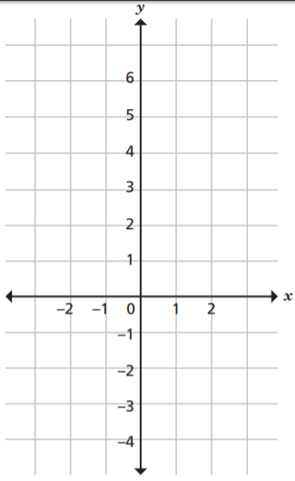
Draw and recognise graphs of the form y = kx
2. a) Complete the table of values for y = -x
b) Write the values in the table as coordinates.
(−2, 2), ( , ), ( , ), ( , ),( , ), ( , )
c) Plot the graph of y = -x
y | -2 | -1 | 0 |  | 2
x | 2 |  |  | -1 |  | -3

Slide 4
Answers

Slide 5
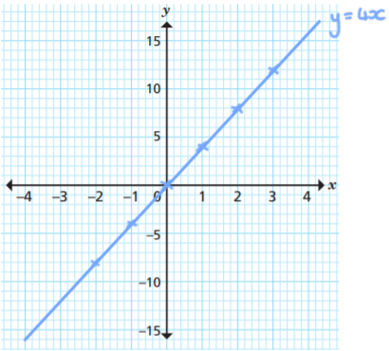
Draw and recognise graphs of the form y = kx
1. a) Complete the table of values for y = 4x
b) Write the values in the table as coordinates.
c) Plot the graph of y = 4x
y | -2 | -1 | 0 | 1 | 2 | 3
x | -8 | -4 | 0 | 4 | 8 | 12
(−2, −8), (-1 ,-4), (0 , 0), (1, 4),(2, 8), (3, 12)

Slide 6
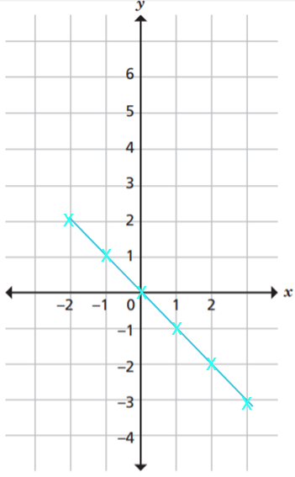
Draw and recognise graphs of the form y = kx
2. a) Complete the table of values for y = -𝑥
b) Write the values in the table as coordinates.
c) Plot the graph of y = -𝑥
y | -2 | -1 | 0 | 1 | 2 | 3
x | 2 | 1 | 0 | -1 | -2 | -3
(−2, 2), (-1, 1), (0, 0), (1, -1),(2, -2), (3, -3)
y = -x

