Slide 1
Unit 8: Decimals
Recognising Common Decimal Equivalents
Independent Task
Mathematics
Lesson 10 of 15
Mr Whitehead
Author’s name goes here

Slide 2
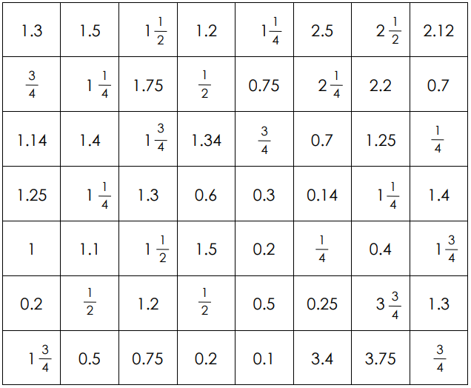
Find and circle the pairs of equivalent fractions that are next to each other

