Slide 1
Solve equations numerically : Change of sign
Maths
Mr Clasper

Slide 2
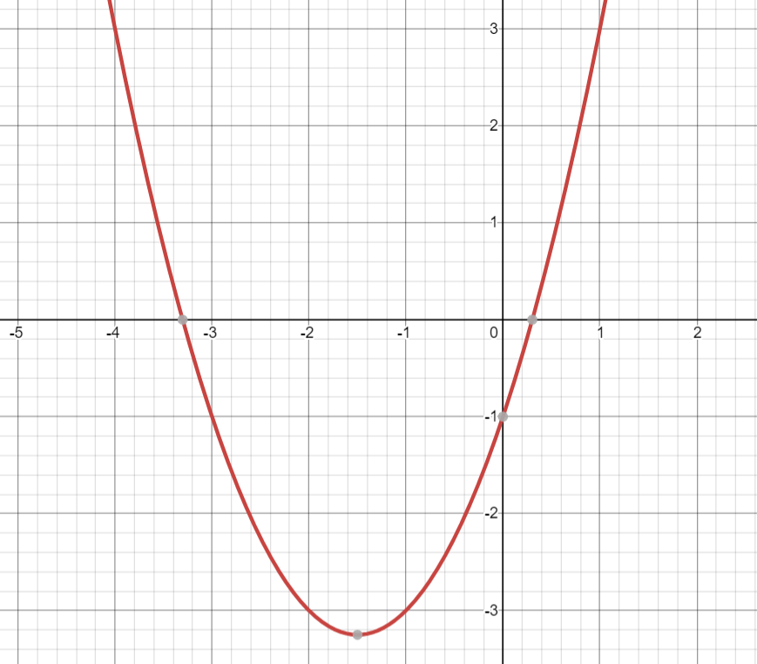
Solve equations numerically : Change of sign
Image created with desmos.com

Slide 3
Solve equations numerically : Change of sign

Slide 4
Answers

Slide 5
Solve equations numerically : Change of sign
Image created with desmos.com

Slide 6
Solve equations numerically : Change of sign
Solving same equation

