Slide 1
Work Out the Gradient of a Line Perpendicular to a Given Line
Maths
Miss Davies
Please note some slides do have colour font on them

Slide 2
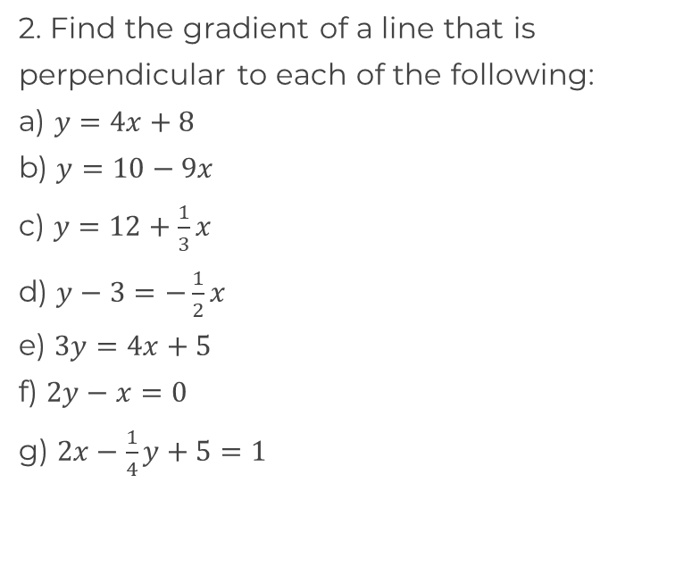
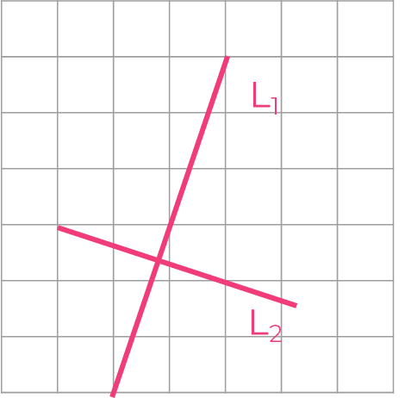
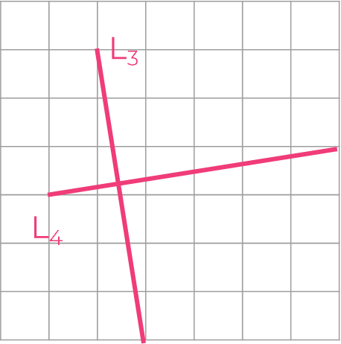
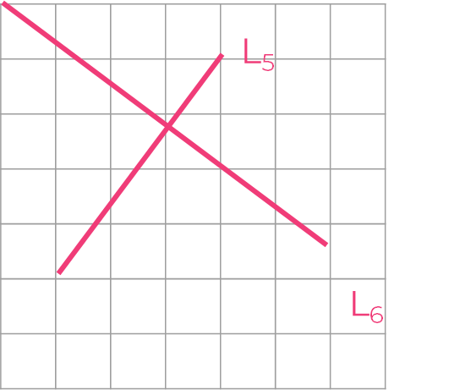
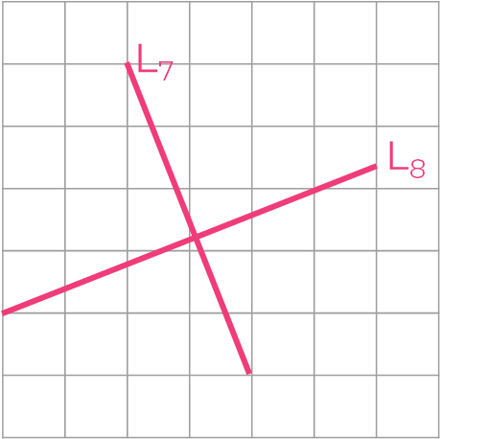
Find the gradient of perpendicular line
1. Work out the gradient of each line
‹#›

Slide 3
Answers

Slide 4
Find the gradient of perpendicular line
1. Work out the gradient of each line
L₁: | L₅:
L₂: | L₆:
L₃: | L₇:
L₄: | L₈:
‹#›

