Slide 1
Exploring calculation strategies
Solving comparison word problems
Maths
Mrs Crane

Slide 2
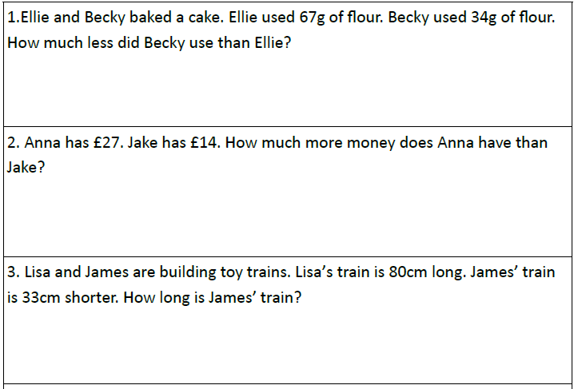
Independent Task
Did you draw a bar model to help you?

Slide 3
Independent Task
Did you draw a bar model to help you?
4. A packet of biscuits costs 45p and a bottle of water costs 39p more. How much does the water cost?
5. Jay’s paddling pool has 90 litres of water. Sally’s paddling pool has 78 litres of water. How many more litres of water are in Jay’s pool than Sally’s?
6. Alice walks 58 metres to her bus stop but she walks 17 fewer metres to school. How far did she walk to school?

