Slide 1
How can Baroque melodies be phrased?
Notes:
Welcome! Excited to be your music teacher today. Name, what I play.
In this lesson, you will need:
A piece of paper
A pencil
An instrument or app to play on iPhone – virtual piano + & the piano keyboard (has recording feature)
Android – Perfect piano
Desktop – onlinepianist.com /virtual-piano
If you’ve not got these items to hand, pause the video, go and get them and then rejoin us.

Slide 2
Quick recap: Which image represents a canon?
What are the other textures?
1
2
3
Notes:
… and how do you know?
Stretch - what are the other textures?

Slide 3
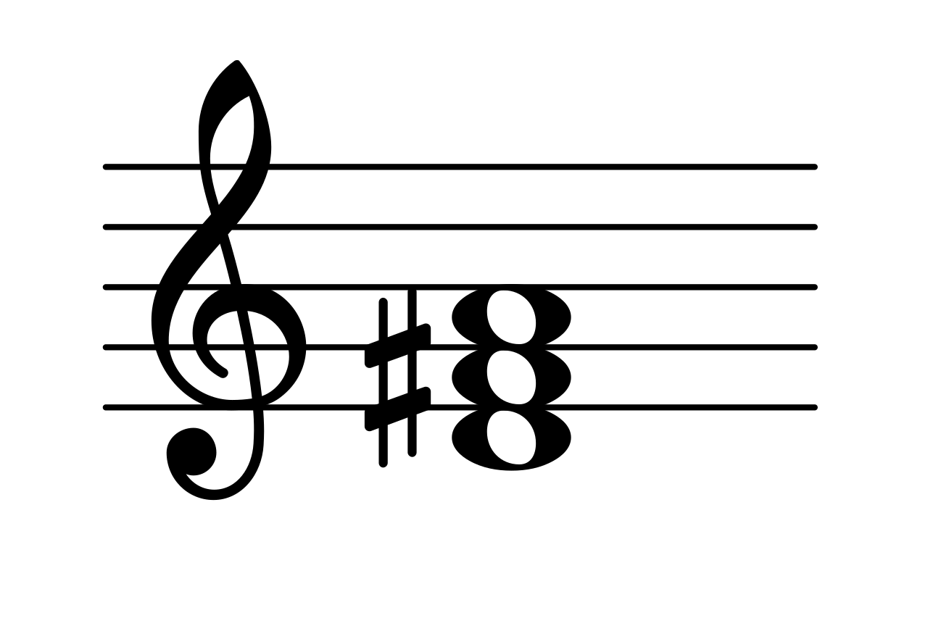
The D major scale
1 2 3 4 5 6 7 8
D major triad
Root
3rd
5th
Octave
Notes:
Model how these create a chord - this is harmony

Slide 4
Try together
Does the melody move in steps or leaps?
Does it ascend or descend?
What notes does it start and end on?
How long is it?
1
B A B C#
Notes:
Play eg. from garageband (keyboard)
Students write down answer

Slide 5
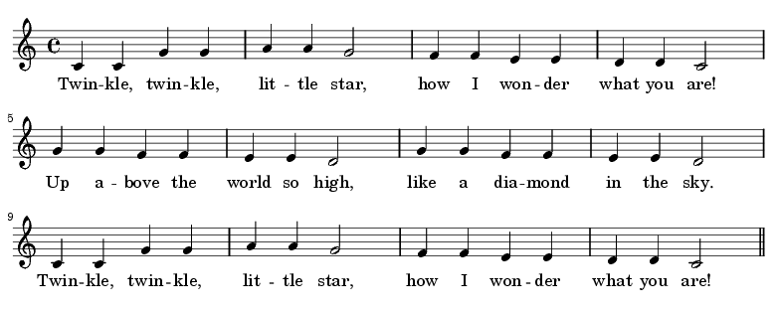
Working out phrases
When do you breathe?
Notes:
Very clear example.

Slide 6
Melodies 1 and 2
1
B A B C#
2
G F# G E
Notes:
Play eg. from garageband (keyboard)
Students write down answer

Slide 7
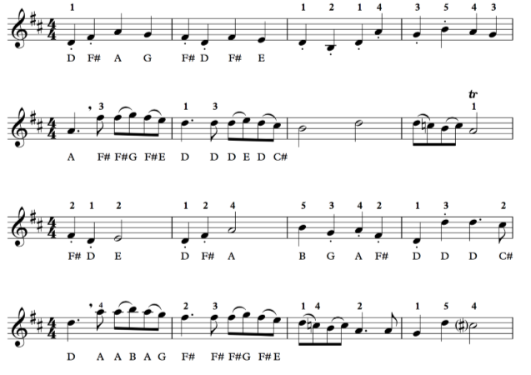
3
D B D A G B A G
4
B D D C B C A
5
6
D C B C A A G D C#
Notes:
Demonstrate

Slide 8
Playing musically
2
3
Slur
4
Notes:
Demonstrate

Slide 9
Making a 12 bar melody
4 bar phrase
4 bar phrase
4 bar phrase
4 bar phrase
2 bar phrase
2 bar phrase
4 bar phrase
8 bar phrase
4 bar phrase
Notes:
Making? Creating? Composing? Building?

Slide 10
Creating your own melody
1
2
4
4
4+ 2+ 2+ 4
2
End on D!
Notes:
Where have I taken the fragments from?
How long are the phrases/
What note to end on?

Slide 11
References
Slide [5] - [Wikimedia Commons] - [Helix84] - [ Twinkle Twinkle Little Star]
Slide [8] - [Wikimedia Commons] - [JLTB84] - [ Crescendo-decrescendo]

