Slide 1
Introducing gamelan - a review of polyrhythms
Music - Pulse, beat, rhythm and structure
Miss Kilpatrick

Slide 2
Information marketplace (10 minute time limit)
To play this activity as a game, give each person in your family one page of information about Indonesia and Gamelan (if you don’t have that many people in your family, one person can have all the information).
You (the customer) asks for information from the seller (person with the information).
The customer must remember that piece of information and write it in the relevant box on the worksheet.
The customer goes back for another piece of information and repeats activity.
Once you have all the information, compare it to the original to see if you remembered everything accurately.
This game is even more fun if the ‘sellers’ sit in different rooms and you give yourself a time limit!

Slide 3
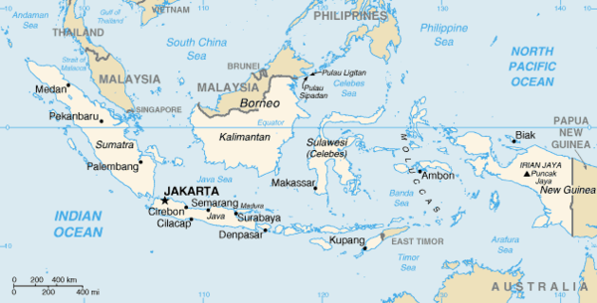
Information for seller 1:
Indonesia
The Republic of Indonesia is made up of more than 17,000 islands of different sizes, lying between Malaysia and the north west of Australia.
The largest islands are Java, Sumatra and Sulawesi. Smaller islands include Bali and Sumba.
Indonesia has a hot tropical climate, with rainforests and active volcanoes.
270 million people live in Indonesia and most live on Java and Bali.

Slide 4
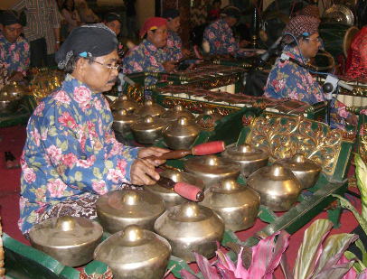
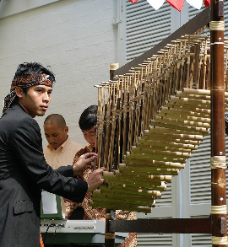
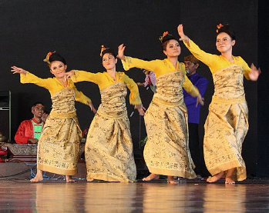
Information for seller 2:
arts and culture of
Indonesia
Music, drama, dance and visual arts are all important parts of Indonesian culture. They are used to mark important life events such as birth, marriage and death.
Musical performances vary on the different islands. Performances will include dances, mask dances, shadow plays and puppet theatres based on ancient Indonesian stories.

Slide 5
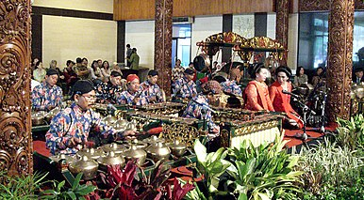
Information for seller 3:
gamelan music
Gamelan is a type of music that everyone takes part in. Gamelan music is memorised and passed down from generation to generation without ever being written down.
The pieces are made up of fixed repeating patterns (ostinati) that the instrumentalist has to learn. These ostinato patterns are layered over each other, creating unusual textures. The ostinai are repeated in cycles ending with a gong.
The music is based on special scales (sets of notes) called Slendro and Pelog.

Slide 6
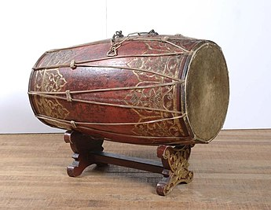
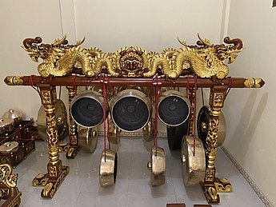
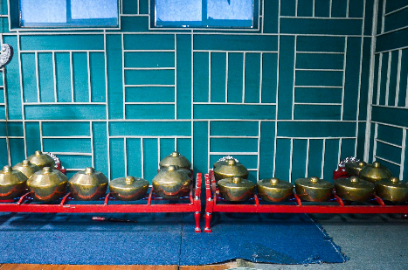
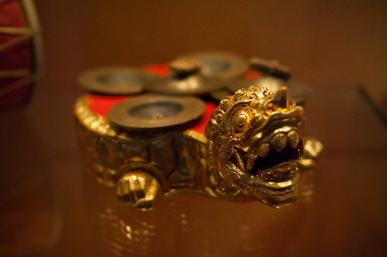
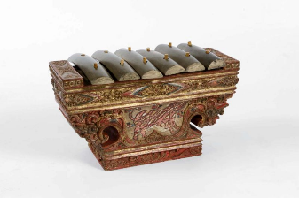
Information for seller 4: examples of instruments of the gamelan
Kendang (drum)
Kempul (gong)
Kenong (gongs)
Saron (metallophone)
Ceng Ceng (cymbal)
Credit: Wikipedia

Slide 7
Customer information table:
Facts about Indonesia | Arts in Indonesia
Facts about gamelan | Instruments of the gamelan

Slide 8
Image references
Slide 3 - Indonesia map: Central Intelligence Agency, Public domain, via Wikimedia Commons
Slide 4 -
1. Kamillo, CC BY-SA 3.0, via Wikimedia Commons
2 & 3. Gunawan Kartapranata, CC BY-SA 3.0, via Wikimedia Commons
Slide 5 - Gunkarta at English Wikipedia, CC BY-SA 3.0 via Wikimedia Commons#
Slide 6 -
Kempul - Culturehistory, CC BY-SA 4.0, via Wikimedia Commons
Saron - Tropenmuseum, part of the National Museum of World Cultures, CC BY-SA 3.0, via Wikimedia Commons
Kenong - Lany pirna, CC BY-SA 4.0, via Wikimedia Commons
Kendang - Tropenmuseum, part of the National Museum of World Cultures, CC BY-SA 3.0, via Wikimedia Commons
Ceng Ceng- sguastevi, CC BY-SA 3.0, via Wikimedia Commons

