Slide 1
Forming shapes from midpoints
Downloadable resource Lesson 5 of 8
Mathematics
Dr Rim Saada

Slide 2
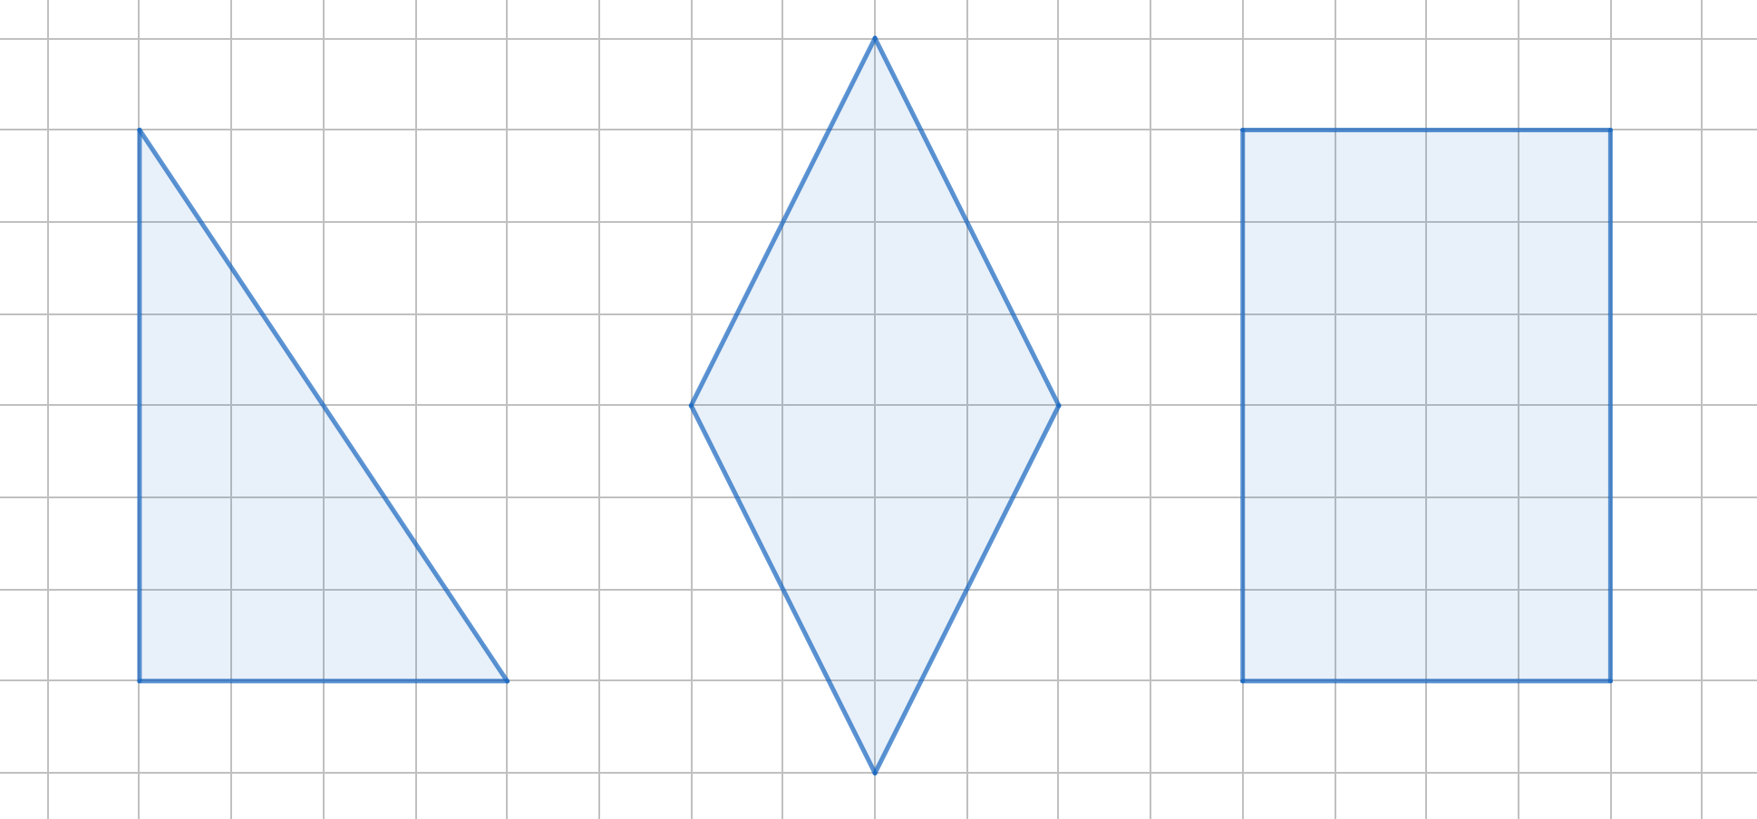
Find the midpoints of the sides of these shapes.
Join the midpoints to form new shapes.

Slide 3
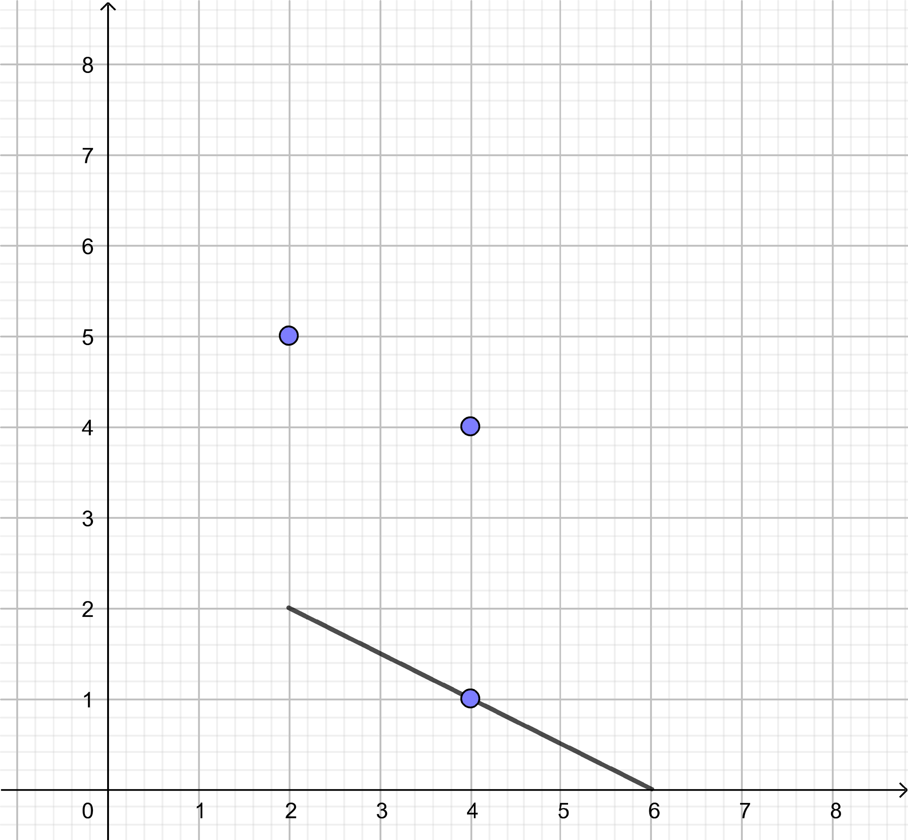
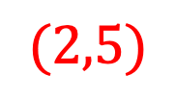
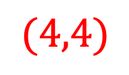
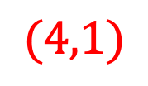
1) The midpoint of one side of a triangle is at (4,1) and that side is shown. What are the coordinates of the vertices of the triangle?
2) A kite with vertices at (0,3), (6,1), (6,5) and (8,3). What shape is formed by joining the midpoints of the sides of the kite? What are the coordinates of its vertices?

Slide 4
Draw the shapes described below.
A rectangle with vertices (4, 1), (4, 7), (2, 7), (2, 1)
A triangle with vertices (−3,1), (−3,−3), (1,−1)
A kite with vertices (−4, 8), (−6, 6), (−4, 0), (−2, 6)
A rhombus with vertices (−2,−5), (2,−3), (6,−5), (2,−7)

