Slide 1
Reflecting in a Given Horizontal or Vertical Line
Maths
Miss Davies

Slide 2
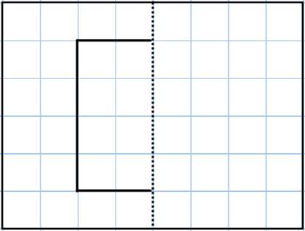
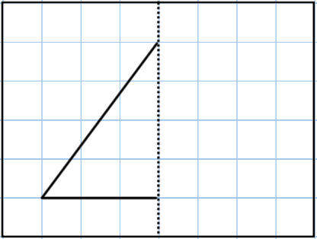
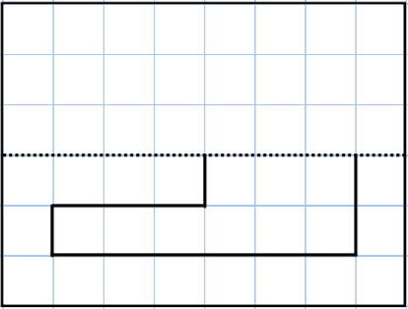
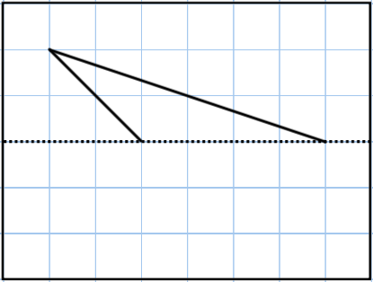
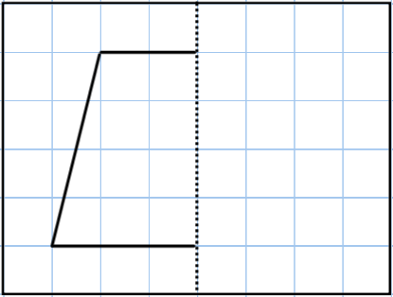
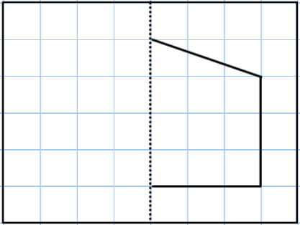
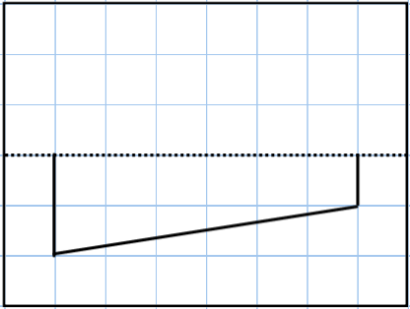
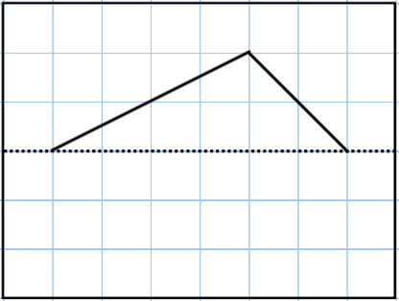
Reflecting in a Given Horizontal or Vertical Line
1. Reflect the shapes in the given lines.
State the mathematical name for the resulting shapes.
2. Reflect the shapes in the given lines.
State the mathematical name for the resulting shapes.

Slide 3
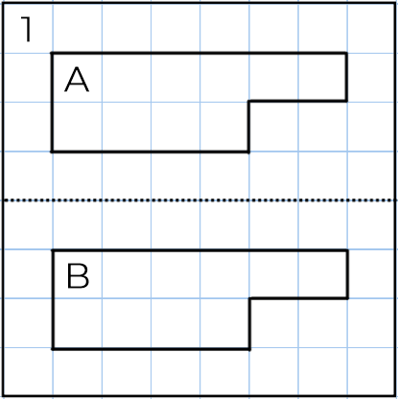
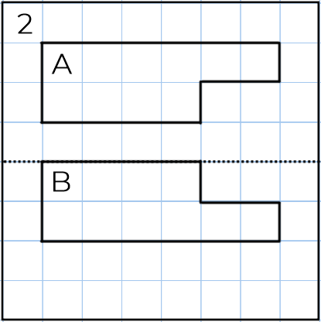
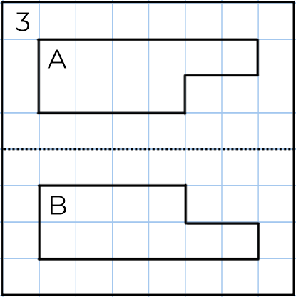
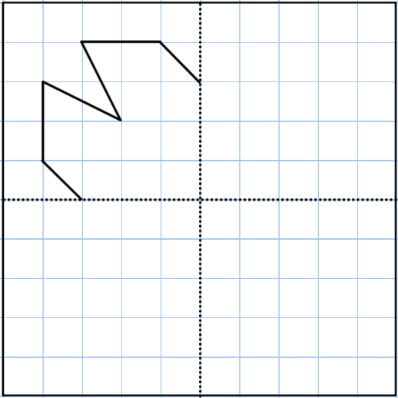
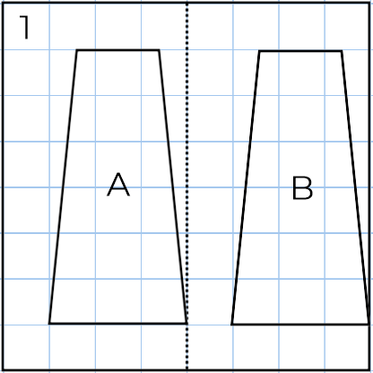
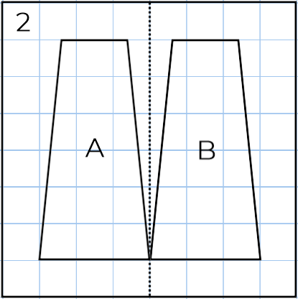
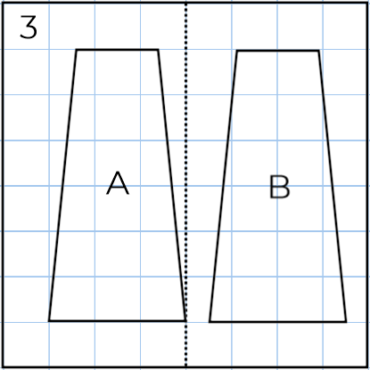
Reflecting in a Given Horizontal or Vertical Line
3. Which of these images shows the correct reflection of shape A?
a)
b)
4. Reflect the shape into all four quadrants.
How many lines of symmetry does the completed shape have?

Slide 4
Answers

Slide 5
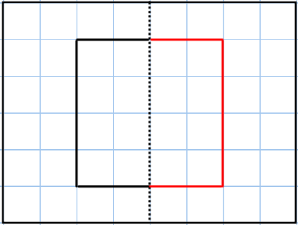
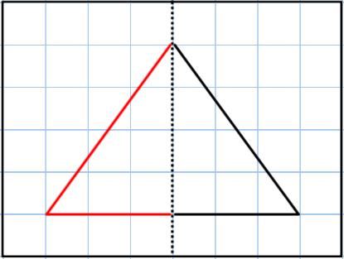
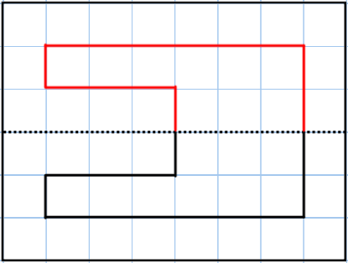
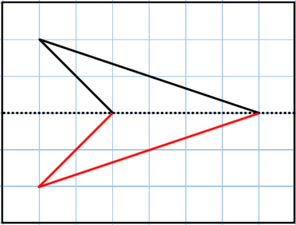
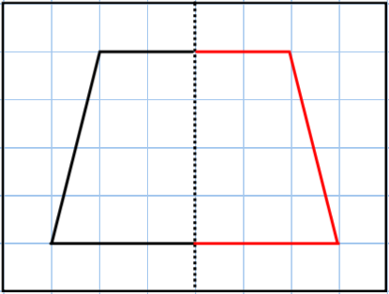
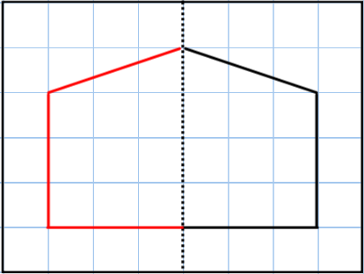
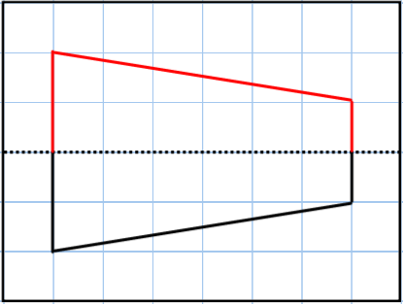
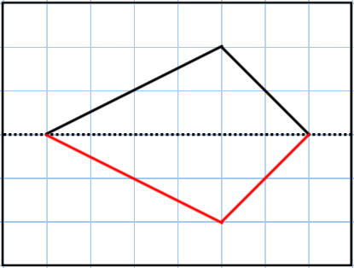
Reflecting in a Given Horizontal or Vertical Line
1. Reflect the shapes in the given lines.
State the mathematical name for the resulting shapes.
2. Reflect the shapes in the given lines.
State the mathematical name for the resulting shapes.
Square
Isosceles Triangle
Compound Shape
Delta
Trapezium
Pentagon
Trapezium
Kite

Slide 6
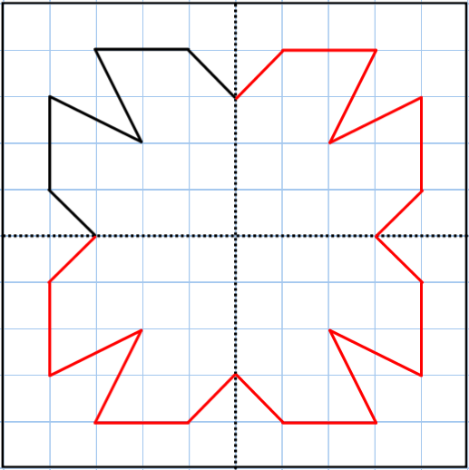
Reflecting in a Given Horizontal or Vertical Line
3. Which of these images shows the correct reflection of shape A?
a)
Image 3
b)
Image 2
4. Reflect the shape into all four quadrants.
How many lines of symmetry does the completed shape have? 4

