Slide 1
Principles of healthy eating
RSHE (PSHE) - Healthy lifestyles: physical fitness and healthy eating
Downloadable Resource
Mr Whitehead
Mr Whitehead

Slide 2
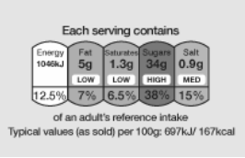
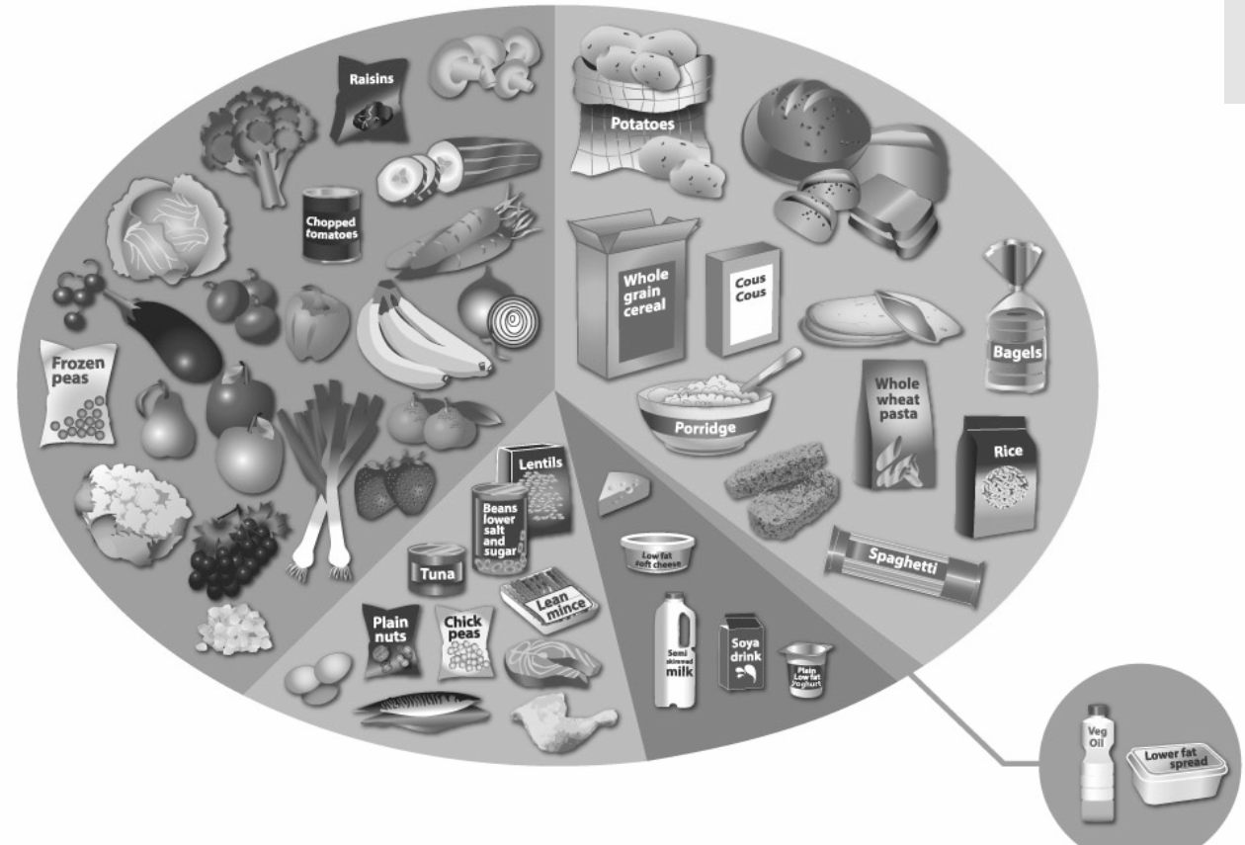
Images: The Eatwell Guide, Food Standards Agency Ⓒ Crown copyright 2020

