Slide 1
Mathematics
Modelling fractions by division 2
Downloadable Resource
Mr Langton

Slide 2
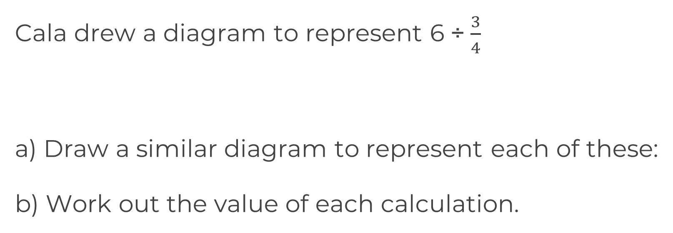
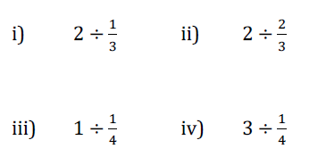
Modelling fractions with division 2
Calculate the following:

