Slide 1
Lesson 2: The RSC Live Event
KS4 - Spreadsheets
Kashif Ahmed
Materials from the Teach Computing Curriculum created by the National Centre for Computing Education

Slide 2
Task 1 - Who uses spreadsheets?
Open the starter activity spreadsheet
Look at the list of jobs in the Who? column
Select a task from the list in column J
There is more than one ‘correct’ answer here, but you can only write one answer in the What For? Column

Slide 3
Task 2 - Add seating prices
Open the spreadsheet called 'RSC Live event seating'.
There are three types of seating and three price points. Students pay 25% of Adult price; Over 60s pay 75% of Adult price.
Use formulae to calculate the discounts and add the seating prices.

Slide 4
Task 3 - Conditional formatting - part 1
First, colour code each section of the seating but keep in mind that you’ll need a fourth colour for indicating sold seats. I used the following colours:
● Premier seating cells H8–Q9 #8064A2 (RGB: 128, 100, 162)
● First Class seating cells F10–S11 #1155CC (RGB: 17, 85, 204)
● Standard seating cells D12–U13 #9bbb59 (RGB: 155, 187, 89)
● Sold seat #F79646 (RGB: 247, 150, 70)

Slide 5
Task 3 - Conditional formatting - part 2
Highlight the Premier seating cells H8–Q9, fill them with a colour.
Then, with cells still highlighted, click on:
Format -> Conditional Formatting.
Check that the selected range is correct. We want to change the cell colour if the cell is not empty. Select a fill colour then click done.

Slide 6
Task 3 - Conditional formatting - part 3
You want to change the cell colour if the cell is not empty.
Repeat for the First Class and Standard seating sections.
Enter any letter into any of these cells. The cell is now not empty and it should change colour.

Slide 7
Task 3 - Conditional formatting - part 4
Highlight the First Class seating cells F10–S11, fill them with a colour. Repeat step 2.
Highlight the Standard seating cells D12–U13, fill them with a colour. Repeat step 2.
Enter any letter into any of these cells; the cell is now not empty and it should change colour.

Slide 8
Task 4 - Data validation - part 1
Data validation is a way to prevent user error by limiting the data a user can input.
For this task, you will create a drop-down list from a range of cells so that the user will be directed to select data from this list.
Three seating sections need data validation adding.

Slide 9
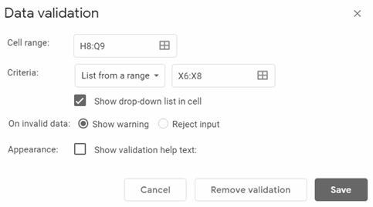
Task 4 - Data validation - part 2
Select the Cell range and the click on:
Data -> Data Validation
Criteria
Click on the waffle to select the cells to be used for the list. (X6:X8)
once done, click Save
Repeat for First Class and Standard seating areas

Slide 10
Task 5 - Counting seats - part 1
Below are the remaining activities for this lesson
Cell X13 a COUNTIF formula
Enter a SUM formula
Premier seats = 20
First Class = 28 seats
Standard = 36 seats
Cells X13–Z15 will all need similar formulae
Enter a formula to calculate how many seats remain in each section

Slide 11
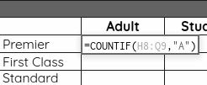
Task 5 - Counting seats - part 2
Begin with cell X13.
Cell X13 requires a formula that will count all the cells in the Premier seating area that have the letter A in them. The formula looks like this:
=COUNTIF(H8:Q9,"A")

Slide 12
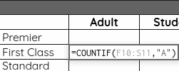
Task 5 - Counting seats - part 3
As the data we are counting is text, we need to use “ “ speech marks around the letter A.
Cell Y13 requires a similar formula to count cells containing S, and cell Z13 requires a formula to count cells containing O.
This pattern needs to be repeated for the First Class seats (X14–Z14)

Slide 13
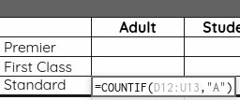
Task 5 - Counting seats - part 4
Repeat the pattern for the Standard seats (X15–Z15)

Slide 14
Task 5 - Counting seats - part 5
Cells AA13–AA15 require a SUM formula to add together the seats sold for each section. Example formula: =SUM(X13:Z13)

Slide 15
Task 5 - Counting seats - part 6
You need to calculate how many seats are still available for sale. Each section has a different number of seats.
● Premier = 20 seats
● First Class = 28 seats
● Standard = 36 seats
The rule here is seats available minus total seats sold in section.
Example formula: =20-AA13

Slide 16
Resume the video now

Slide 17
Task 6 - Calculate income - part 1
For Now that the spreadsheet is almost complete you can use some of the cells you’ve already set up to help calculate the income from seat sales.
There’s a lot of repetition in this section so make sure you work methodically. The rule here is: number of seats sold multiplied by seat price. Example formula for cell X20:
=X13*AB6

Slide 18
Task 6 - Calculate income - part 2
Cells X20–Z22
Enter a formula to calculate the income from selling Premier seats to adults, then use a similar formula to calculate the income from selling seats to students and the over 60s.

Slide 19
Task 6 - Calculate income - part 3
Cells AA20–AA22
Enter a SUM formula in cell AA20 to add together the totals for Premier seating sales then use the fill handle to drag this formula down.
You could enter the formulae in cells X20–Z20 then use the fill handle to drag down the formula.

Slide 20
Task 6 - Calculate income - part 4
Cell AA23
Enter a SUM formula to add together the totals for each seating section for a final total.

Slide 21
Resume the video now

