Slide 1
Drawing Venn Diagrams
Mathematics
Miss Oreyomi
Miss Oreyomi

Slide 2
Questions

Slide 3
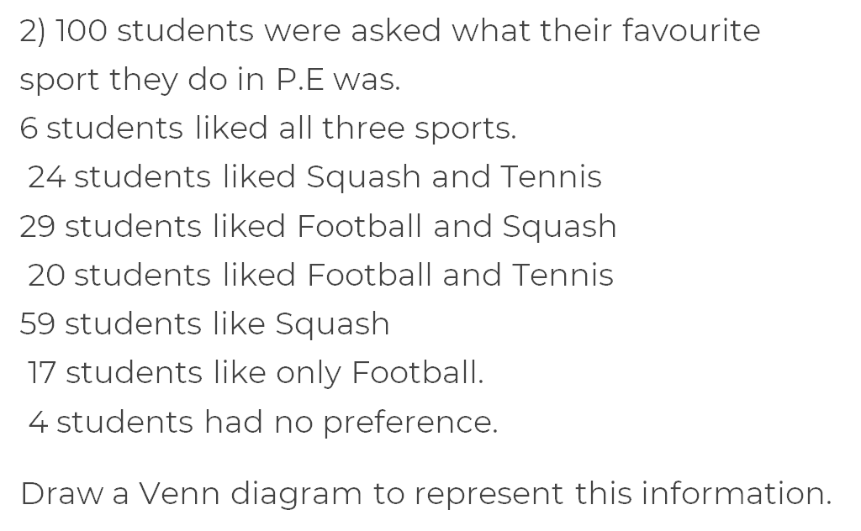
Questions

Slide 4
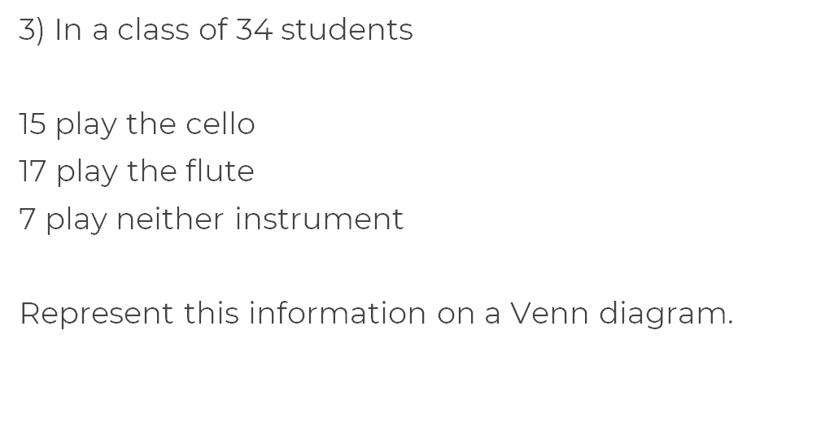
Questions

