Slide 1
Represent decimal numbers in a variety of ways
Independent Task
Mathematics
Miss Parsons

Slide 2
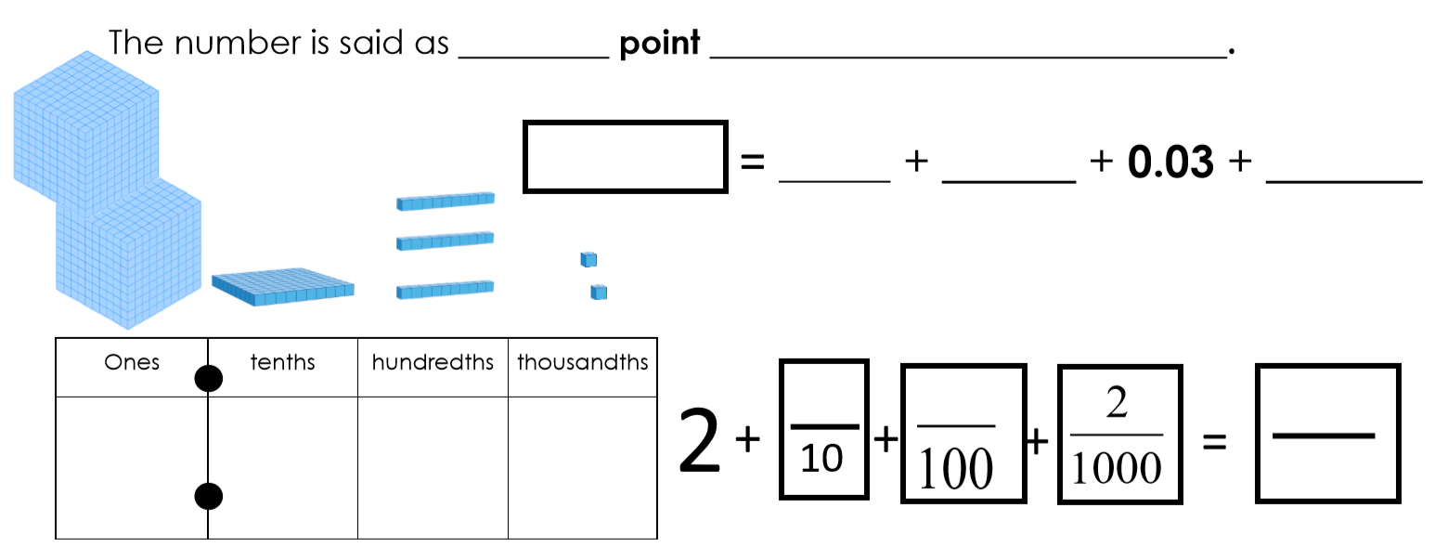
Task 1

Slide 3
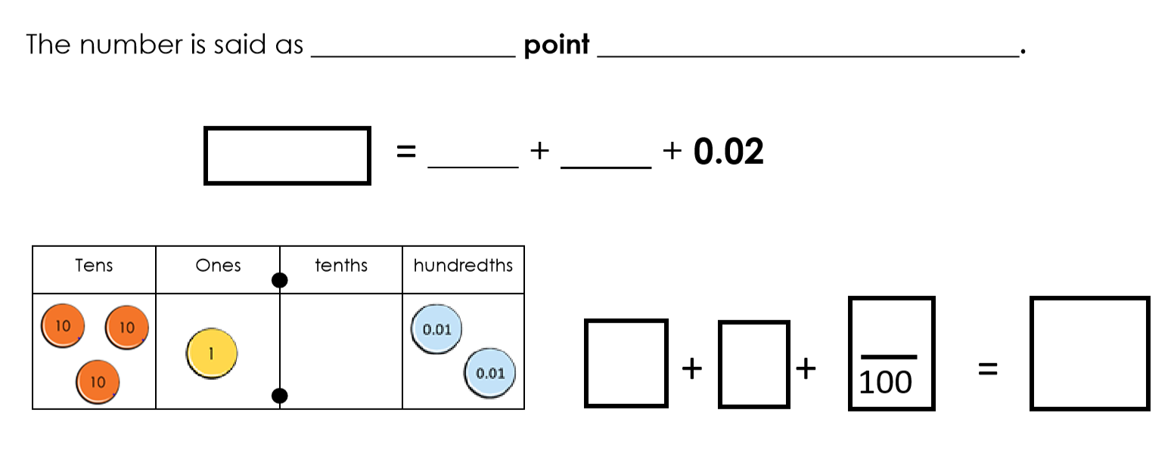
Task 2

