Slide 1
Lesson 3: The FDE cycle
Computer systems
Computing
Mac Bowley
Materials from the Teach Computing Curriculum created by the National Centre for Computing Education

Slide 2
Task 1 - Task name
Carries data around the CPU
Regulates the cycles per second
Instructs the other components
Carries out mathematical operations
Fast access memory locations in the CPU
Which component of the CPU is described in each line of this table?

Slide 3
Fetch-decode-execute jumble
Fetch
Decode
Execute
1
2
3
4
5
6
7
8
9
The CPU executes the instruction
Instructions are loaded into RAM from secondary memory
The instruction is transferred via the data bus to the CPU
The result may be stored back into RAM
The CPU may fetch data held in memory if referenced in the instruction
The instructions are stored in RAM in numbered memory locations
The CPU sends a signal requesting an instruction from a specific location in RAM
The cycle repeats
The CPU decodes the instruction

Slide 4
The FDE cycle in action
Instruction
Question 1
Open oaknat.uk/comp-101comp-lmc
Change the program using the dropdown menu in the bottom left hand corner, you want “Adding 2 inputs” (Hint on next slide)
Run the program using the “Run Program” button. Watch the log as it runs
What does num1 represent on lines 2 & 4?
Question 2
What is the instruction number for INP?

Slide 5
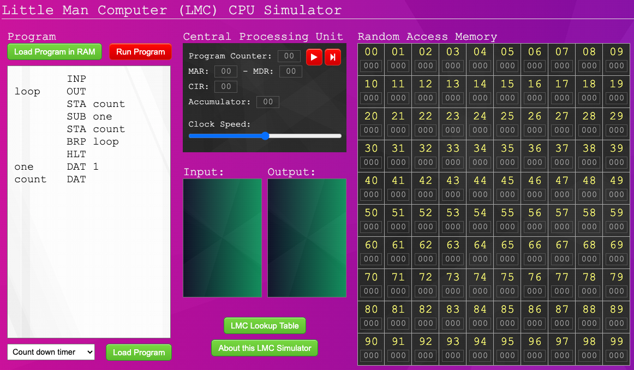
The FDE cycle in action - Part 1
Change the program using the dropdown menu in the bottom left hand corner, you want “Adding 2 inputs”
Credit: Philippe Kerampran, 101computing

Slide 6
The FDE cycle in action - Part 2
Use the tables on the next 2 pages to note down what each component is doing during the cycle.
Credit: Philippe Kerampran, 101computing

Slide 7
The FDE cycle in action
Component | Fetch | Decode | Execute
Control Unit
ALU
Buses
Accumulator

Slide 8
The FDE cycle in action
Component | Fetch | Decode | Execute
Memory address register
Memory data register
Current instruction register
Program counter

