Slide 1
Finding the Surface Area of Triangular Prisms
Maths
Miss Davies

Slide 2
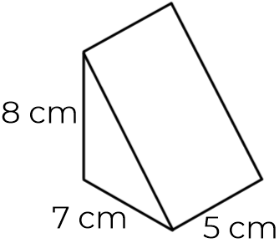
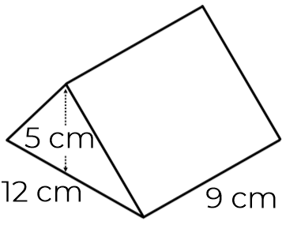
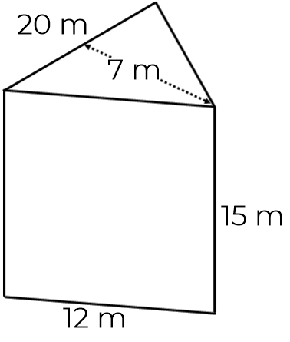
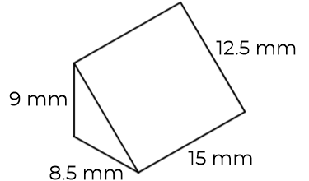
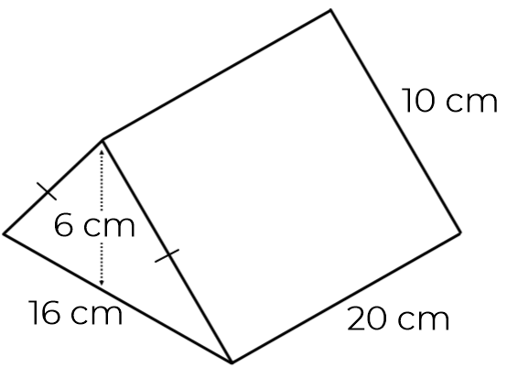
Surface Area of Triangular Prisms
1. Calculate the surface area.
a) b)
c) d)
2. Calculate the surface area of an equilateral triangular prism.
The cross section has a base of 6 cm and a height of 5 cm. The prism has a depth of 8 cm.
3. Calculate the surface area of the isosceles triangular prism.
11 cm
8 cm
7 cm
8 cm
12 cm
9 cm
7 cm
5 cm
20 m
10 cm
12.4 mm
9 mm
10 cm
15 m
8.5 mm
15 mm
16 cm
20 cm
12 m

Slide 3
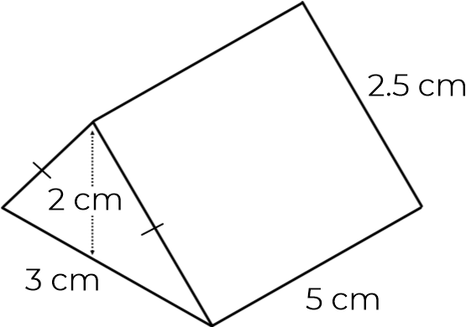
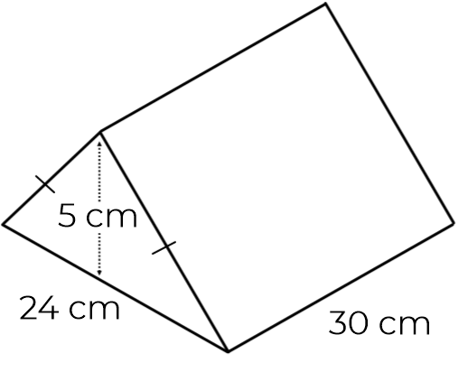
Surface Area of Triangular Prisms
4. Rory is finding the surface area of an isosceles triangular prism.
Rory is wrong.
What mistake has he made?
5. Find the surface area of the isosceles triangular prism.
2.5 cm
3 cm
5 cm
24 cm
30 cm

Slide 4
Answers

Slide 5
Surface Area of Triangular Prisms
1. Calculate the surface area.
a) 186 cm² b) 303 cm²
c) 770 m² d) 525 mm²
2. Calculate the surface area of an equilateral triangular prism.
The cross section has a base of 6 cm and a height of 5 cm. The prism has a depth of 8 cm.
174 cm²
3. Calculate the surface area of the isosceles triangular prism.
11 cm
8 cm
7 cm
8 cm
12 cm
9 cm
7 cm
5 cm
20 m
10 cm
12.4 mm
9 mm
816 cm²
10 cm
15 m
8.5 mm
15 mm
16 cm
20 cm
12 m

Slide 6
Surface Area of Triangular Prisms
4. Rory is finding the surface area of an isosceles triangular prism.
Rory is wrong.
What mistake has he made?
The base (15cm²) only appears once.
The correct answer is 46 cm².
5. Find the surface area of the isosceles triangular prism.
1620 cm²
2.5 cm
3 cm
5 cm
24 cm
30 cm

