Slide 1
Fractions:
Add fractions
Independent Task
Mathematics
Miss Parsons

Slide 2
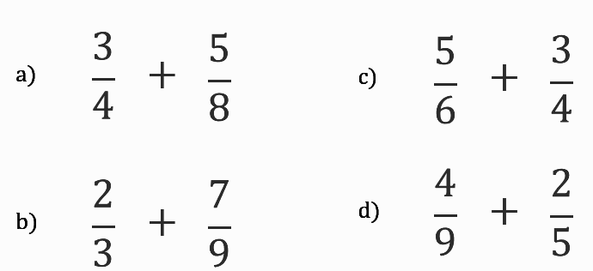
Question 1
Add the fractions below:

Slide 3
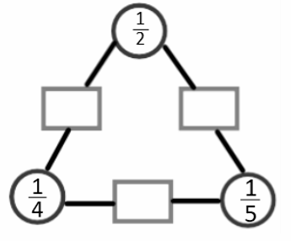
Question 2
Add two fractions in the red circles to find the total in the grey box between them.

Slide 4
Question 3
Complete the sequence. Ensure that your answers are mixed numbers in their simplest form.

Slide 5
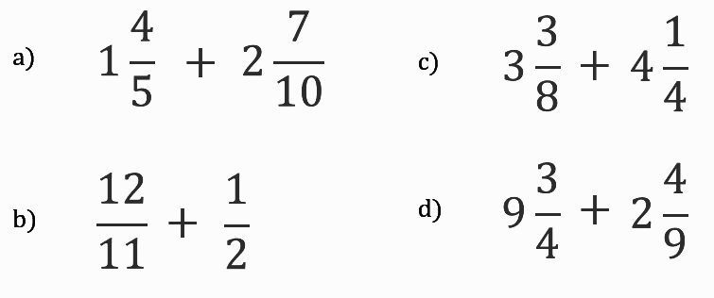
Question 4
Add the fractions below:

Slide 6
Question 5
Fran, Hassan and Novie order some pizzas.
Fran eats of a pizza, Hassan eats and Novie eats .
How many pizzas did they order and what fraction is left?

