Slide 1
To compare fractions with the same denominator
Worksheet
Maths
Mr Etherton

Slide 2
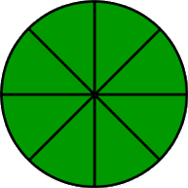
Part 1
Complete the missing boxes in the table to compare the fractions.
No. | Fraction 1 | <, > or = | Fraction 2 | Statement
E.g. | 3 4 | > | 1 4 | One quarter is less than three quarters.
2) | 4 8
3) |  | =
4) | Five tenths |  |  | One tenth is less than five tenths.

Slide 3
Part 2
There were 30 strawberries in a bag.
Aisha ate one tenth of the strawberries.
Khaled ate five tenths of the strawberries.
Who ate fewer strawberries?
Draw your own mathematical pictures to compare fractions.
Use the correct symbol to compare their
relationship.
>
> Greater than < Less than = is equal to

