Slide 1
Independent Living Unit 4 - Community Living
Lesson 6 - Travel in the community
Oak Specialist
Building Understanding

Slide 2
Unit 4- Community Living
Lesson 2- Shopping in the supermarket
Lesson 1- Knowing which shop to buy from
Writing a shopping list, choosing the correct aisle and counting money.
Which shops sell what items? Matching shopping to shops.
Lesson 4- Familiar health services
Lesson 3- What’s on the high street?
Recognising familiar health professionals and matching jobs to their roles.
Recognising and locating places of interest on a high street.
Lesson 5- Transport
Lesson 6- Travel in the community
Identifying transport modes and choosing correct mode for type of travel.
Planning a simple journey.

Slide 3
Teacher notes- Lesson 6
Travel in the community
Learning Intentions: To plan a simple journey
What to remember to take when travelling. Collect the items that you might need.
Favourite places to visit. Have you travelled before?
Safe ways to travel. What to remember when travelling.
Planning a journey. Opportunity for role play.
Resources- pen and paper, travel items.
Notes:
Plan of the lesson.

Slide 4
Lesson Stages:
What to remember when traveling.
Favourite places to visit.
Safe ways to travel.
Plan a journey.
Notes:
Read through the lesson stages with your learner.

Slide 5
What to remember when travelling?
cat money map flowers
bag fish television ticket
Notes:
Note: add in or draw images and items that best suit your learner.
Look at the table- what are the items you need from the list to travel?
Ask- do you need a TV or a ticket for the bus?

Slide 6
Favourite places to travel
Where do you like to travel?
How do you get there?
What do you need to take with you?
Swimming pool Beach
?
Shops Family Cinema
Notes:
Task: Ask you learner the questions in the thought bubble. Add in pictures to support if needed. Use your images, symbols or drawings from the last slide to help your learner decide what they need to travel with.

Slide 7
Safe ways to travel
Road Safety | 2. Plan your journey ahead | 3. Travel with an adult
4. Is the driver wearing a name badge? | 5. Stranger Danger | 6. Carry a water bottle, especially on hotter days and long journeys
Notes:
Read through each numbered box with your learner and discuss the importance of travelling safely. Add in images or symbols that best suit your learner.

Slide 8
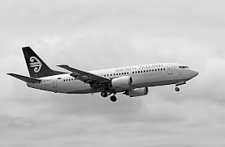
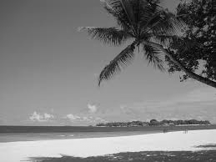
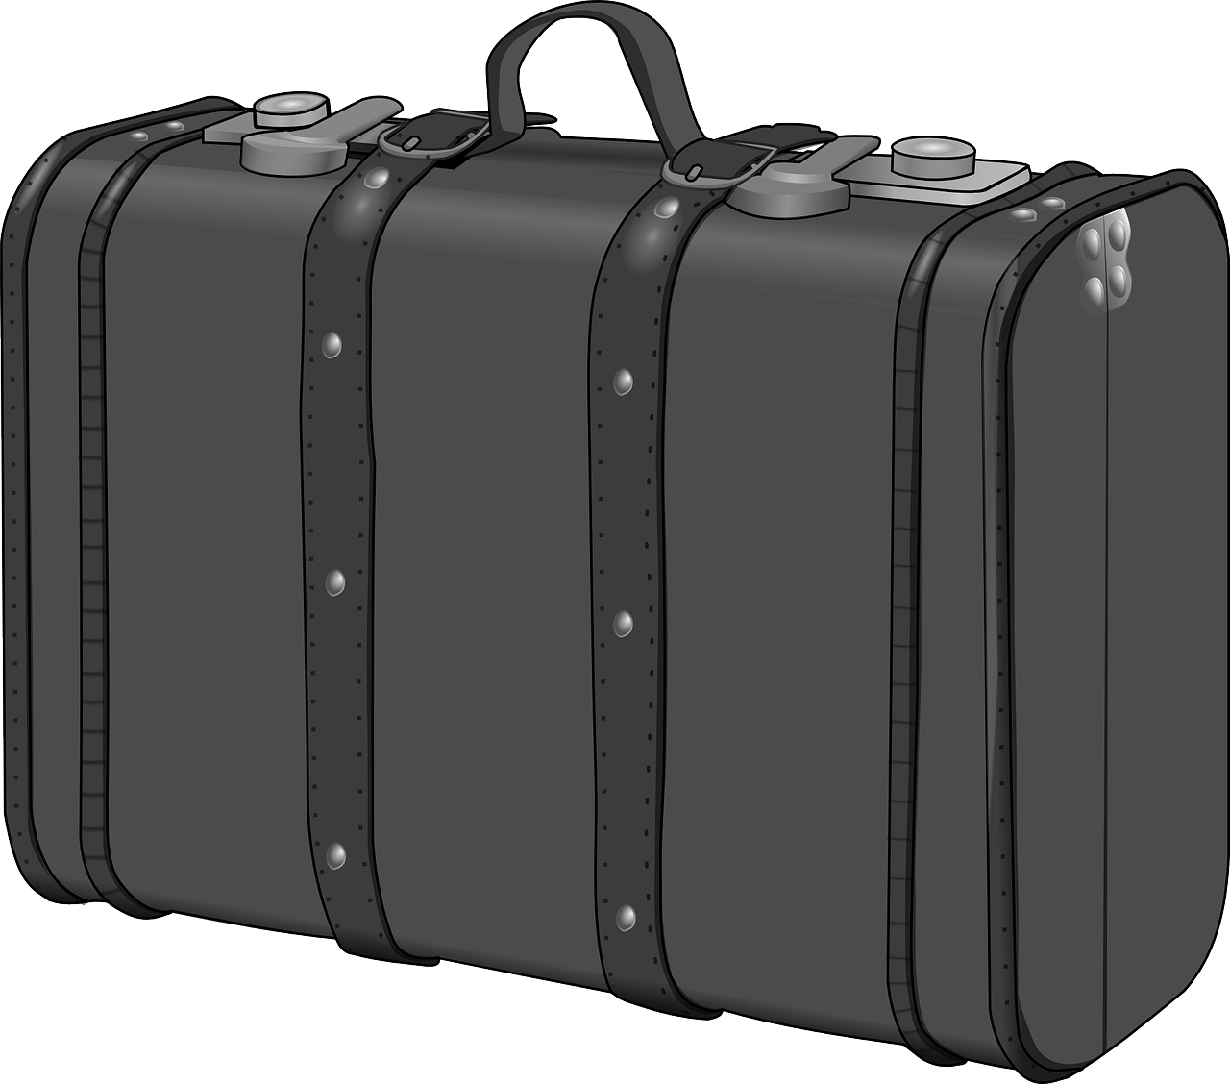
Plan a journey
Task: Think of a journey you are going to do with your learner - either going to the shops, a cafe, a school trip or even a holiday.
This can be a real trip or made up.
- Ask your learner how they will get to the place.
-What do they need to pack to get there?
-How to do it safely.
Pack a bag with the items you need- you can make your own tickets together.
Role play going on the journey, or enjoy going on the real journey.
How?
Where?
What to pack?
Notes:
Task: Think of a journey you are going to do with your learner- either going to the shops, a cafe, a school trip or even a holiday.
This can be a real trip or made up.
-Ask your learner how they will get to the place.
-What do they need to pack to get there.
-How to do it safely.
Pack a bag with the items you need- you can make your own tickets together.
Role play going on the journey, or enjoy going on the real journey.

Slide 9
Independent Living: Community Living
Travel in the local community: Suggested adaptations for teachers / parents / carers.
Make it easier
Make it harder
More ideas
Have a selection of real items, such as a passport, train tickets, money to use when discussing items and role playing.
Ask your parent or carer to help you use the internet to plan a trip - use Google Earth to search different countries and find exciting holiday destinations.
Have a look at how to book a trip online, such as to the zoo, or at the cinema (with parent/carer).
Take photographs of your journey and make a photo album of your trip. Write notes under each photograph and refer back to it in the future.
Notes:
Suggested adaptations for teachers/parents.

Slide 10
Further Learning with Oak National
Independent Living:
Applying Learning- Preparing for a trip (Unit 3)
Applying Learning- Road safety (Unit 6)
Applying Learning- Safety on transport (Unit 6)
Applying Learning- Travel in the community/planning a journey (Unit 4)
Building Understanding- Transport (Unit 4)

Slide 11
References
Slide 10- Beach Maldives Vacations Palm Island Sun Bandos, Max Pixel / Suitcase, Pixabay / Aeroplane boeing 737, Pixabay / Money, Wallpaper Flare / British Passport, Geordie Bosanko, Wikimedia Commons

